Slide 1
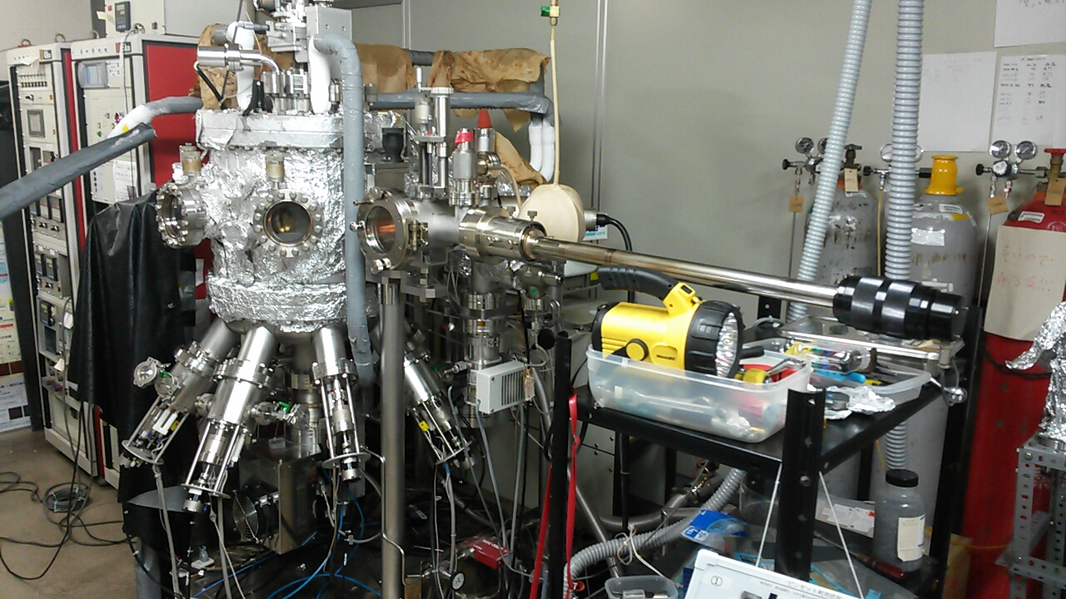
RHEED CCD Camera
Main Chamber
Load-lock Chamber
Transfer cane
Liquid Nitrogen
H* chamber
Cells

